Slide 1
2024 ENAR DataFest –
Is Obesity Associated with the Worsening of Blood Pressure Control?
Sreejata Dutta and Xiaosong Shi
Department of Biostatistics & Data Science,
University of Kansas Medical Center
January 16, 2024

Slide 2
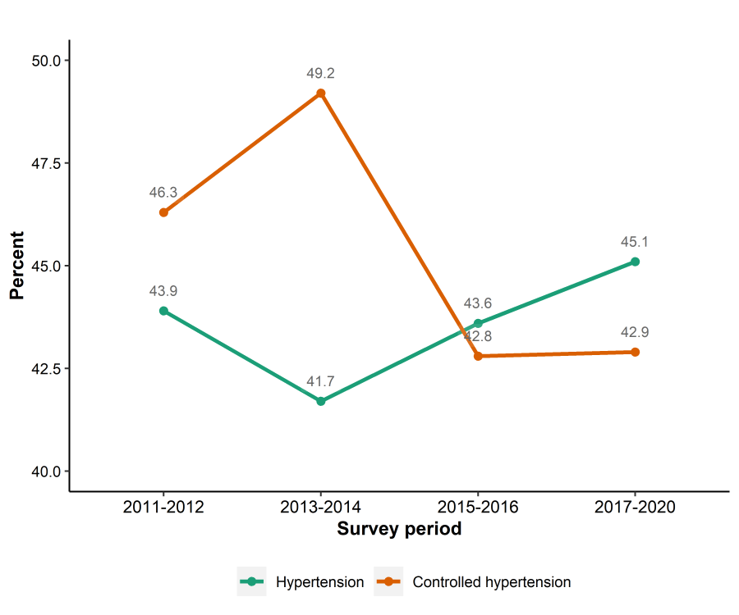
PROBLEM STATEMENT
2
Hypertension –
Poses a significant risk for cardiovascular diseases
Its prevalence, however, has remained high in the U.S. over the past decade
New definition (130/80 mmHg) by ACC and AHA led to a ~10% increase in cases
Bramlage et al. concluded a correlation between incident hypertension and obesity.
The objective of this study is to explore if obesity is associated with worsening blood pressure (BP) control among U.S. adults with hypertension over the past decade.
Figure 1: Age-adjusted trends in hypertension and controlled hypertension among the U.S. adults aged 18 and over from 2011 to March 2020.

Slide 3
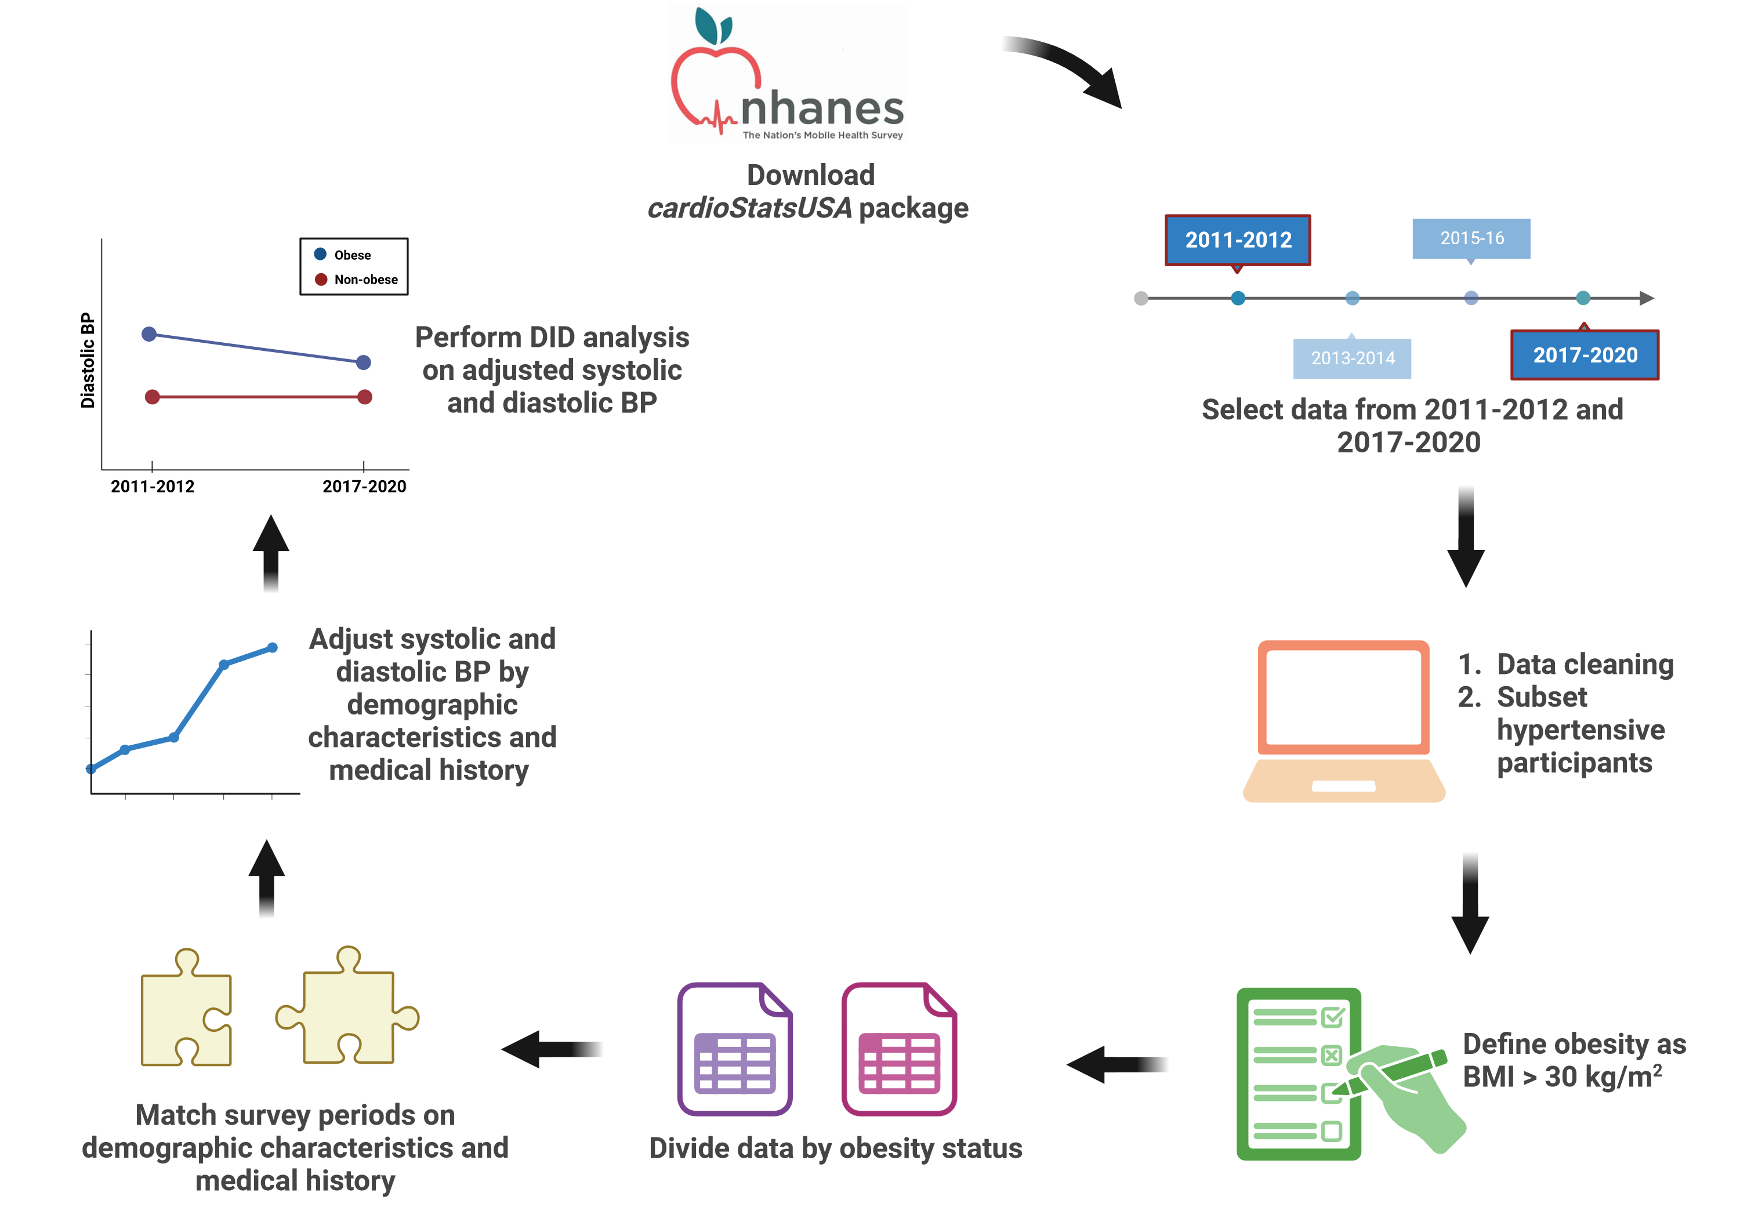
STATISTICAL ANALYSIS OVERVIEW
3
Figure 2: Study workflow.
Figure created with BioRender.com

Slide 4
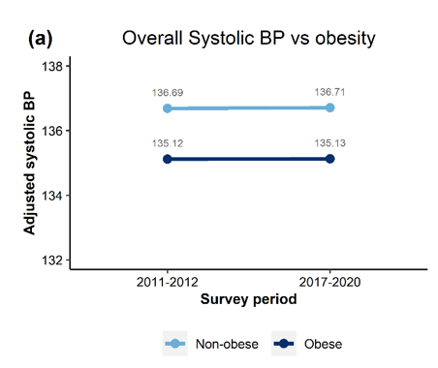
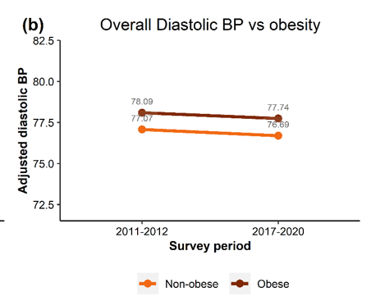
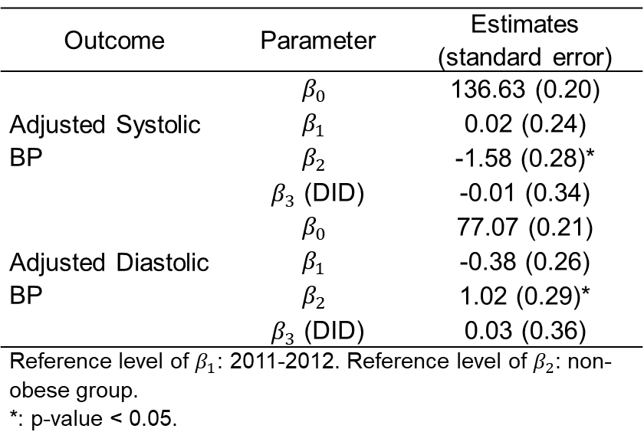
KEY RESULTS: Primary analysis
4
The Difference-in-Differences (DID) model:
$$Y=β_{0}+β_{1}\left[\text{survey} \text{period}\right]+β_{2}\left[\text{obesity}\right]+β_{3}\left[\text{survey} \text{period}×\text{obesity}\right]+ε$$
Table 1: Overall results from DID analyses.
Outcome | Parameter | Estimates (standard error)
Adjusted Systolic BP | $$β_{0}$$ | 136.63 (0.20)
 | $$β_{1}$$ | 0.02 (0.24)
 | $$β_{2}$$ | -1.58 (0.28)*
 | $β_{3}$ (DID) | -0.01 (0.34)
Adjusted Diastolic BP | $$β_{0}$$ | 77.07 (0.21)
 | $$β_{1}$$ | -0.38 (0.26)
 | $$β_{2}$$ | 1.02 (0.29)*
 | $β_{3}$ (DID) | 0.03 (0.36)
Reference level of $β_{1}$: 2011-2012. Reference level of $β_{2}$: non-obese group. *: p-value < 0.05.
Figure 3: Visualization of DID estimates across obesity statuses.

Slide 5
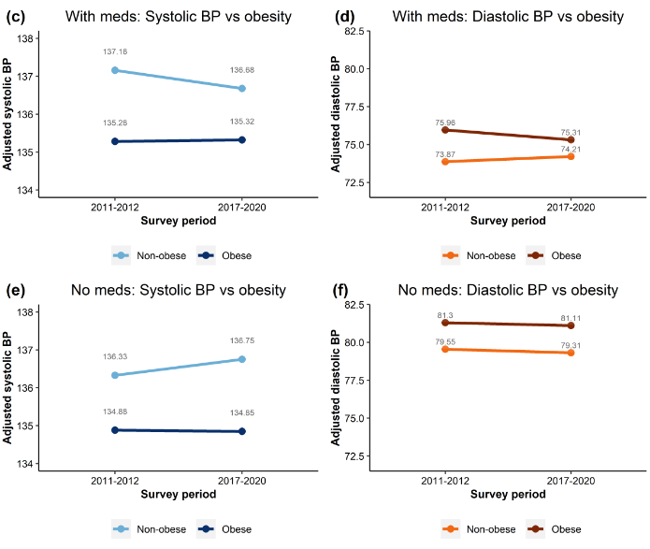
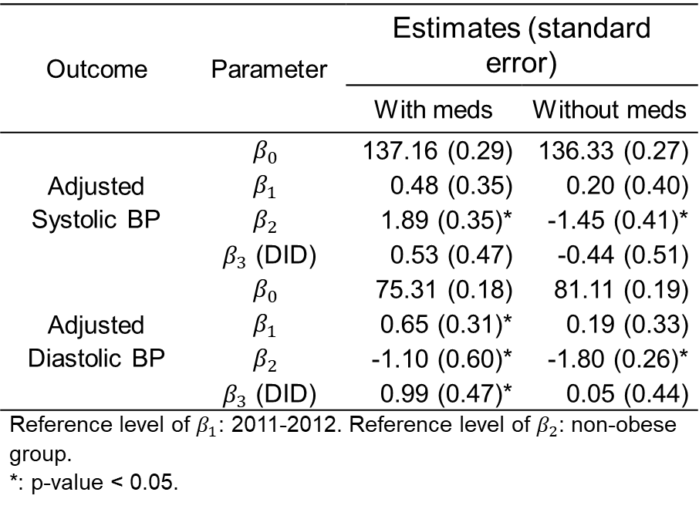
KEY RESULTS: Subgroup analyses
5
(a)
(b)
Table 2: Results from subgroup analyses.
Outcome | Parameter | Estimates (standard error)
 |  | With meds | Without meds
Adjusted Systolic BP | $$β_{0}$$ | 137.16 (0.29) | 136.33 (0.27)
 | $$β_{1}$$ | 0.48 (0.35) | 0.20 (0.40)
 | $$β_{2}$$ | 1.89 (0.35)* | -1.45 (0.41)*
 | $β_{3}$ (DID) | 0.53 (0.47) | -0.44 (0.51)
Adjusted Diastolic BP | $$β_{0}$$ | 75.31 (0.18) | 81.11 (0.19)
 | $$β_{1}$$ | 0.65 (0.31)* | 0.19 (0.33)
 | $$β_{2}$$ | -1.10 (0.60)* | -1.80 (0.26)*
 | $β_{3}$ (DID) | 0.99 (0.47)* | 0.05 (0.44)
Reference level of $β_{1}$: 2011-2012. Reference level of $β_{2}$: non-obese group. *: p-value < 0.05.
(c)
(d)
Figure 4: Visualization of DID estimates across obesity statuses by antihypertensive medication use.

Slide 6
CONCLUSIONS
6
Obesity is not significantly associated with the worsening of BP control over the last decade.
When considering the use of antihypertensive medication, our findings affirm that it is possible that the hypertensive patients’ diastolic BP can be lowered over time, irrespective of obesity status (Parikh et al., 2018).
Limitations:
Reduced sample size due to missing data.
Results may vary if employ alternative matching algorithms.
We failed in investigating the association between BP control and sodium intake over time, due to challenges in matching results due to missing and self-reported dietary data.

Slide 7
REFERENCES
7
Bramlage, P., Pittrow, D., Pittrow, D., Kirch, W., Boehler, S., Lehnert, H., et al. (2004) Hypertension in overweight and obese primary care patients is highly prevalent and poorly controlled. American Journal of Hypertension, 17, 904–910.
CDC. (2021) National Center for Health Statistics Mortality Data on CDC WONDER. . URL https://wonder.cdc.gov/Deaths-by-Underlying-Cause.html [accessed 14 January 2024]
Erem, C., Hacihasanoglu, A., Kocak, M., Deger, O. and Topbas, M. (2008) Prevalence of prehypertension and hypertension and associated risk factors among Turkish adults: Trabzon Hypertension Study. Journal of Public Health, 31, 47–58.
Fryar, C.D., Ostchega, Y., Hales, C.M., Zhang, G. and Kruszon-Moran, D. (2017) Hypertension Prevalence and Control Among Adults: United States, 2015-2016. NCHS data brief, 1–8.
Gupta, D.K., Lewis, C.E., Varady, K.A., Su, Y.R., Madhur, M.S., Lackland, D.T., et al. (2023) Effect of Dietary Sodium on Blood Pressure. JAMA, 330, 2258.
Jiang, S.-Z., Lu, W., Zong, X.-F., Ruan, H.-Y. and Liu, Y. (2016) Obesity and hypertension. Experimental and Therapeutic Medicine, 12, 2395–2399.
Kundu, S., Rahman, Md.A., Kabir, H., Al Banna, Md.H., Hagan Jr., J.E., Srem-Sai, M., et al. (2022) Diabetes, Hypertension, and Comorbidity among Bangladeshi Adults: Associated Factors and Socio-Economic Inequalities. Journal of Cardiovascular Development and Disease, 10, 7.
Oyawa, I., Adhiambo, M., Wesonga, B., Wanzala, M., Adungo, F., Makwaga, O., et al. (2022) Burden of hypertension and associated factors among HIV positive adults in Busia County, Kenya. Pan African Medical Journal, 43.
Parikh, J.S., Randhawa, A.K., Wharton, S., Edgell, H. and Kuk, J.L. (2018) The Association between Antihypertensive Medication Use and Blood Pressure Is Influenced by Obesity. Journal of Obesity, 2018, 1–11.
Singh, S., Shankar, R. and Singh, G.P. (2017) Prevalence and Associated Risk Factors of Hypertension: A Cross-Sectional Study in Urban Varanasi. International Journal of Hypertension, 2017, 1–10.
Sukhram, S.D., Zarini, G.G., Shaban, L.H., Vaccaro, J.A. and Huffman, F.G. (2022) Microalbuminuria and Hypertension among Immigrants with Type 2 Diabetes: A Community-Based Cross-Sectional Study. Journal of Personalized Medicine, 12, 1777.

